Slide 1
Module-4
CELLSITE AND MOBILE ANTENNAS

Slide 2
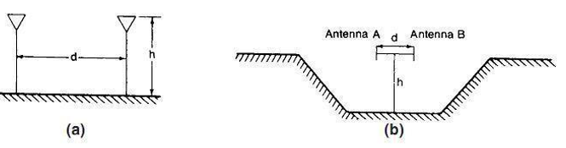
SPACES-DIVERSITY ANTENNAS
Two-branch space-diversity antennas are used at the cell site to receive the same signal with different fading envelopes, one at each antenna.
The degree of correlation between two fading envelopes is determined by the degree of separation between two receiving antennas. When the two fading envelopes are combined, the degree of fading is reduced. Here the antenna setup is shown in Fig

Slide 3
Contd..
Equation is presented as an example for the designer to use.
η = h/D = 11 (8.13-1)
Where h is the antenna height and D is the antenna separation. From Eq., the separation d ≥ 8λ is needed for an antenna height of 100 ft (30 m) and the separation d ≥ 14λ is needed for an antenna height of 150 ft (50 m). In any Omni cell system, the two space-diversity antennas should be aligned with the terrain, which should have a U shape as shown in Fig.
Space-diversity antennas can separate only horizontally, not vertically; thus, there is no advantage in using a vertical separation in the design

Slide 4
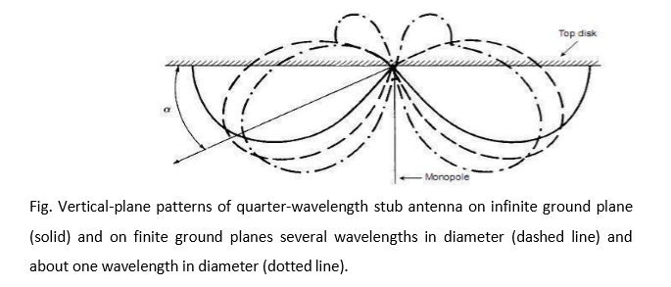
UMBRELLAS-PATTERN ANTENNAS
In certain situations, umbrella-pattern antennas should be used for the cell-site antennas.

Slide 5
Contd..
i) NORMAL UMBRELLA-PATTERN ANTENNA:
For controlling the energy in a confined area, the umbrella-pattern antenna can be developed by using a
monopole with a top disk (top-loading) as shown in Fig. The size of the disk determines the tilting angle of the
pattern. The smaller the disk, the larger the tilting angle of the umbrella pattern.
ii) BROADBAND UMBRELLA-PATTERN ANTENNA:
The parameters of a Discone antenna (a bio conical antenna in which one of the cones is extended to
180◦ to form a disk) are shown in Fig. The diameter of the disk, the length of the cone, and the opening of the
cone can be adjusted to create an umbrella-pattern antenna.

Slide 6
Contd..
iii) INTERFERENCE REDUCTION ANTENNA:
A design for an antenna configuration that reduces interference in two critical directions (areas) is shown
in Fig.6.3. The parasitic (insulation) element is about 1.05 times longer than the active element.
iv) HIGH-GAIN BROADBAND UMBRELLA-PATTERN ANTENNA:
A high-gain antenna can be constructed by vertically stacking a number of umbrella-
pattern as shown in the fig.

Slide 7
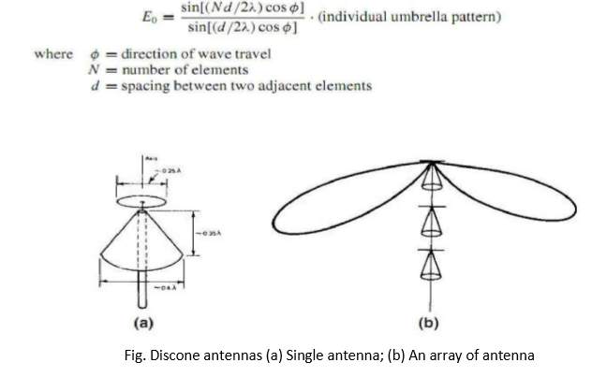
Contd..

Slide 8
MINIMUM SEPARATION OF CELL-SITE RECEIVING ANTENNAS
Separation between two transmitting antennas should be minimized to avoid the inter modulation. The minimum separation between a transmitting antenna and a receiving antenna is necessary to avoid receiver desensitization. Here we are describing a minimum separation between two receiving antennas to reduce the antenna pattern ripple effects. The two receiving antennas are used for a space-diversity receiver.
Because of the near field disturbance due to the close spacing, ripples will form in the antenna patterns (Fig.). The difference in power reception between two antennas at different angles of arrival is shown in Fig. .
If the antennas are located closer; the difference in power between two antennas at a given pointing angle increases. Although the power difference is confined to a small sector, it affects a large section of the street as shown in Fig. .

Slide 9
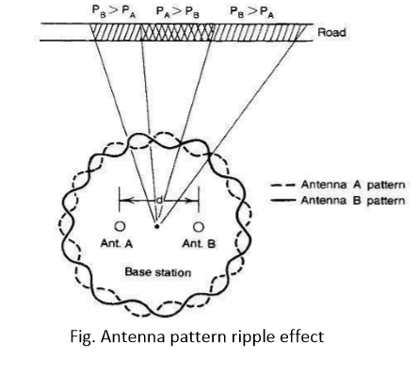
Contd..
If the power difference is excessive, use of space diversity will have no effect reducing fading. At 850 MHz, the separation of eight wavelengths between two receiving antennas creates a power difference of ±2 dB, which is tolerable for the advantageous use of a diversity scheme.

Slide 10
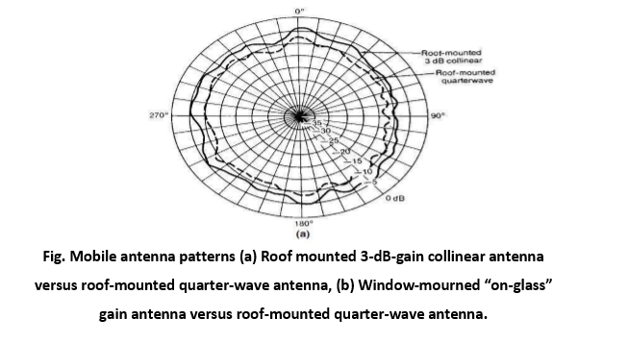
MOBILE ANTENNAS
The requirement of a mobile (motor-vehicle–mounted) antenna is an Omni-directional antenna that can be located as high as possible from the point of reception. However, the physical limitation of antenna height on the vehicle restricts this requirement. Generally, the antenna should at least clear the top of the vehicle. Patterns for two types of mobile antenna are shown in Fig.

Slide 11
ROOF-MOUNTED ANTENNA:
The antenna pattern of a roof-mounted antenna is more or less uniformly distributed around the mobile unit when measured at an antenna range in free space as shown in Fig.9.2.
The 3-dBhigh-gain antenna shows a 3- dBgain over the quarter-wave antenna. However, the gain of the antenna used at the mobile unit must be limited to 3 dB because the cell-site antenna is rarely as high as the broadcasting antenna and out-of-sight conditions often prevail.
The mobile antenna with a gain of more than 3 dB can receive only a limited portion of the total multipath signal in the elevation as measured under the out-of-sight condition

Slide 12
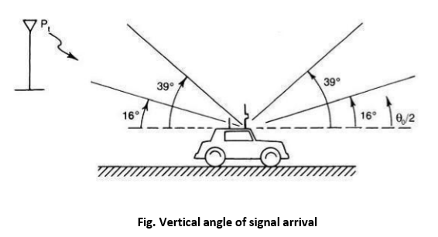

Slide 13
GLASS-MOUNTED ANTENNAS:
There are many kinds of glass-mounted antennas. Energy is coupled through the glass; therefore, there is no need to drill a hole. However, some energy is dissipated on passage through the glass. The antenna gain range is 1 to 3 dB depending on the operating frequency.
The position of the glass-mounted antenna is always lower than that of the roof-mounted antenna; generally there is a 3-dBdifference between these two types of antenna. Also, glass mounted antennas cannot be installed on the shaded glass found in some motor vehicles because this type of glass has a high metal content.

Slide 14
MOBILE HIGH-GAIN ANTENNAS:
A high-gain antenna used on a mobile unit has been studied. This type of high-gain antenna should be distinguished from the directional antenna. In the directional antenna, the antenna beam pattern is suppressed horizontally; in the high-gain antenna, the pattern is suppressed vertically.
To apply either a directional antenna or a high-gain antenna for reception in a radio environment, we must know the origin of the signal. If we point the directional antenna opposite to the transmitter site, we would in theory receive nothing. In a mobile radio environment, the scattered signals arrive at the mobile unit from every direction with equal probability. That is why an Omni directional antenna must be used .
The scattered signals also arrive from different elevation angles. Lee and Brandt used two types of antenna, one λ/4 whip antenna with elevation coverage of 39◦ and one 4-dB-gain antenna (4-dB gain with respect to the gain of a dipole) with elevation coverage of 16◦ and measured the angle of signal arrival in the suburban
Keyport-Matawan area of New Jersey. There are two types of test: a line-of-sight condition and an out-of-sight condition. In Lee and Brandt’s study, the transmitter was located at an elevation of approximately 100 m (300 ft) above sea level.

Slide 15
Contd..
The measured areas were about 12 m (40 ft) above sea level and the path length about 3 mi. The received signal from the 4-dB-gain antenna was 4 dB stronger than that from the whip antenna under line-of- sight conditions. This is what we would expect.
However, the received signal from the 4-dB-gain antenna was only about 2 dB stronger than that from the whip antenna under out-of-sight conditions. This is surprising. The reason for the latter observation is that the scattered signals arriving under out-of- sight conditions are spread over a wide elevation angle. A large portion of the signals outside the elevation angle of 16◦ cannot be received by the high-gain antenna.
We may calculate the portion being received by the high-gain antenna from the measured beam width. For instance, suppose that a 4:1 gain (6 dBi) is expected from the high-gain antenna, but only 2.5:1 is received. Therefore, 63 percent of the signal is received by the 4-dB-gain antenna (i.e., 6 dBi) and 37 percent is felt in the region between 16 and 39◦

Slide 16
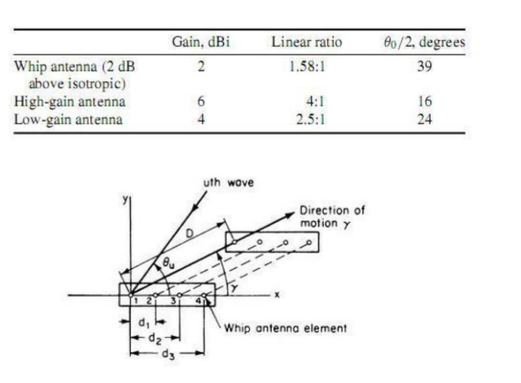
Contd..
Therefore, a 2- to 3-dB-gain antenna (4 to 5 dBi) should be adequate for general use. An antenna gain higher than 2 to 3 dB does not serve the purpose of enhancing reception level. Moreover, measurements reveal that the elevation angle for scattered signals received in urban areas is greater than that in suburban areas.

